Slide 1
Greedy algorithms
Thanks to David Kauchak

Slide 2
Interval scheduling
Given n activities A = [a₁,a₂, .., a_{n}] where each activity has start time s_{i} and a finish time f_{i}. Schedule as many as possible of these activities such that they don’t conflict.

Slide 3
Interval scheduling
Given n activities A = [a₁,a₂, .., a_{n}] where each activity has start time s_{i} and a finish time f_{i}. Schedule as many as possible of these activities such that they don’t conflict.
Which activities conflict?

Slide 4
Interval scheduling
Given n activities A = [a₁,a₂, .., a_{n}] where each activity has start time s_{i} and a finish time f_{i}. Schedule as many as possible of these activities such that they don’t conflict.
Which activities conflict?

Slide 5
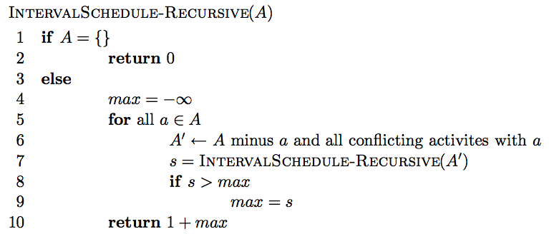
Simple recursive solution
Enumerate all possible solutions and find which schedules the most activities

Slide 6
Simple recursive solution
Is it correct?
  max{all possible solutions}
Running time?
  O(n!)

Slide 7
Can we do better?
Dynamic programming
O(n²)
Greedy solution – Is there a way to repeatedly make local decisions?
  Key: we’d still like to end up with the optimal solution

Slide 8
Overview of a greedy approach
Greedily pick an activity to schedule
Add that activity to the answer
Remove that activity and all conflicting activities. Call this A’.
Repeat on A’ until A’ is empty

Slide 9
Greedy options
Select the activity that starts the earliest, i.e. argmin{s₁, s₂, s₃, …, s_{n}}?

Slide 10
Greedy options
Select the activity that starts the earliest, i.e. argmin{s₁, s₂, s₃, …, s_{n}}?
non-optimal

Slide 11
Greedy options
Select the shortest activity, i.e.
argmin{f₁-s₁, f₂-s₂, f₃-s₃, …, f_{n}-s_{n}}

Slide 12
Greedy options
Select the shortest activity, i.e.
argmin{f₁-s₁, f₂-s₂, f₃-s₃, …, f_{n}-s_{n}}
non-optimal

Slide 13
Greedy options
Select the activity with the smallest number of conflicts

Slide 14
Greedy options
Select the activity with the smallest number of conflicts

Slide 15
Greedy options
Select the activity with the smallest number of conflicts

Slide 16
Greedy options
Select the activity that ends the earliest, i.e. argmin{f₁, f₂, f₃, …, f_{n}}?

Slide 17
Greedy options
Select the activity that ends the earliest, i.e. argmin{f₁, f₂, f₃, …, f_{n}}?
remove the conflicts

Slide 18
Greedy options
Select the activity that ends the earliest, i.e. argmin{f₁, f₂, f₃, …, f_{n}}?

Slide 19
Greedy options
Select the activity that ends the earliest, i.e. argmin{f₁, f₂, f₃, …, f_{n}}?

Slide 20
Greedy options
Select the activity that ends the earliest, i.e. argmin{f₁, f₂, f₃, …, f_{n}}?
remove the conflicts

Slide 21
Greedy options
Select the activity that ends the earliest, i.e. argmin{f₁, f₂, f₃, …, f_{n}}?

Slide 22
Greedy options
Select the activity that ends the earliest, i.e. argmin{f₁, f₂, f₃, …, f_{n}}?

Slide 23
Greedy options
Select the activity that ends the earliest, i.e. argmin{f₁, f₂, f₃, …, f_{n}}?

Slide 24
Greedy options
Select the activity that ends the earliest, i.e. argmin{f₁, f₂, f₃, …, f_{n}}?

Slide 25
Greedy options
Select the activity that ends the earliest, i.e. argmin{f₁, f₂, f₃, …, f_{n}}?
Multiple optimal solutions

Slide 26
Greedy options
Select the activity that ends the earliest, i.e. argmin{f₁, f₂, f₃, …, f_{n}}?

Slide 27
Greedy options
Select the activity that ends the earliest, i.e. argmin{f₁, f₂, f₃, …, f_{n}}?

Slide 28
Efficient greedy algorithm
Once you’ve identified a reasonable greedy heuristic:
  Prove that it always gives the correct answer
  Develop an efficient solution

Slide 29
Is our greedy approach correct?
“Stays ahead” argument:
show that no matter what other solution someone provides you, the solution provided by your algorithm always “stays ahead”, in that no other choice could do better

Slide 30
Is our greedy approach correct?
“Stays ahead” argument
Let r₁, r₂, r₃, …, r_{k} be the solution found by our approach
Let o₁, o₂, o₃, …, o_{k} of another optimal solution
Show our approach “stays ahead” of any other solution
…
r₁
r₂
r₃
r_{k}
…
o₁
o₂
o₃
o_{k}

Slide 31
Stays ahead
…
r₁
r₂
r₃
r_{k}
…
o₁
o₂
o₃
o_{k}
Compare first activities of each solution
what do we know?

Slide 32
Stays ahead
…
r₁
r₂
r₃
r_{k}
…
o₁
o₂
o₃
o_{k}
finish(r₁) ≤ finish(o₁)
what does this imply?

Slide 33
Stays ahead
…
r₂
r₃
r_{k}
…
o₂
o₃
o_{k}
We have at least as much time as any other solution to schedule the remaining 2…k tasks

Slide 34
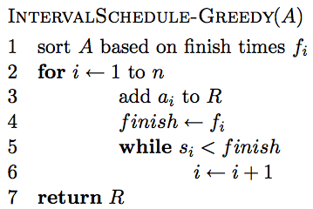
An efficient solution

Slide 35
Running time?
Θ(n log n)
Θ(n)
Better than:
O(n!)
O(n²)
Overall: Θ(n log n)

Slide 36
Scheduling all intervals
Given n activities, we need to schedule all activities. Goal: minimize the number of resources required.

Slide 37
Greedy approach?
The best we could ever do is the maximum number of conflicts for any time period

Slide 38
Calculating max conflicts efficiently

Slide 39
Calculating max conflicts efficiently
3

Slide 40
Calculating max conflicts efficiently
1

Slide 41
Calculating max conflicts efficiently
3

Slide 42
Calculating max conflicts efficiently
1

Slide 43
Calculating max conflicts efficiently
…

Slide 44
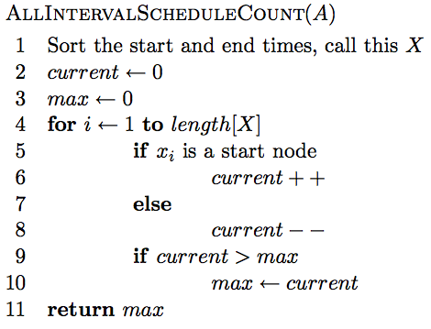
Calculating max conflicts

Slide 45
Correctness?
We can do no better then the max number of conflicts. This exactly counts the max number of conflicts.

Slide 46
Runtime?
O(2n log 2n + n) = O(n log n)

Slide 47
Horn formulas
Horn formulas are a particular form of boolean logic formulas
They are one approach to allow a program to do logical reasoning
Boolean variables: represent some event
  x = the murder took place in the kitchen
  y = the butler is innocent
  z = the colonel was asleep at 8 pm

Slide 48
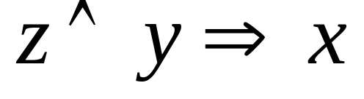
Implications
Left-hand side is an AND of any number of positive literals
Right-hand side is a single literal
  x = the murder took place in the kitchen
  y = the butler is innocent
  z = the colonel was asleep at 8 pm
What does this implication mean in English?

Slide 49
Implications
Left-hand side is an AND of any number of positive literals
Right-hand side is a single literal
If the colonel was asleep at 8 pm and the butler is innocent then the murder took place in the kitchen
  x = the murder took place in the kitchen
  y = the butler is innocent
  z = the colonel was asleep at 8 pm

Slide 50

Implications
Left-hand side is an AND of any number of positive literals
Right-hand side is a single literal
  x = the murder took place in the kitchen
  y = the butler is innocent
  z = the colonel was asleep at 8 pm
What does this implication mean in English?

Slide 51
Implications
Left-hand side is an AND of any number of positive literals
Right-hand side is a single literal
the murder took place in the kitchen
  x = the murder took place in the kitchen
  y = the butler is innocent
  z = the colonel was asleep at 8 pm

Slide 52
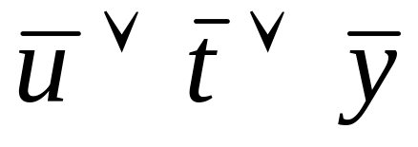
Negative clauses
An OR of any number of negative literals
  u = the constable is innocent
  t = the colonel is innocent
  y = the butler is innocent
What does this clause mean in English?

Slide 53
Negative clauses
An OR of any number of negative literals
not every one is innocent
  u = the constable is innocent
  t = the colonel is innocent
  y = the butler is innocent

Slide 54
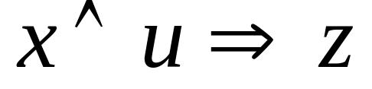
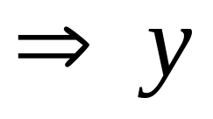
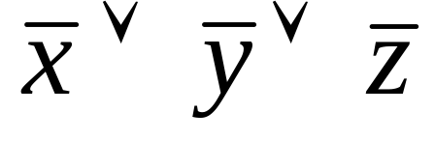
Horn formula
A horn formula is a set of implications and negative clauses:

Slide 55
Goal
Given a horn formula, determine if the formula is satisfiable, i.e. an assignment of true/false to the variables that is consistent with all of the implications/causes
u x y z
0 1 1 0

Slide 56
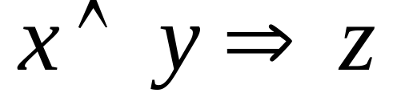
Goal
Given a horn formula, determine if the formula is satisfiable, i.e. an assignment of true/false to the variables that is consistent with all of the implications/causes
u x y z
not satifiable

Slide 57
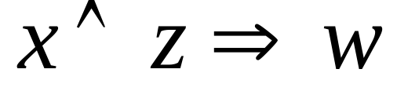
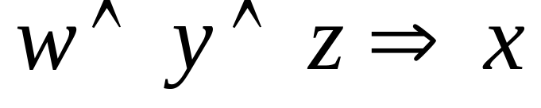
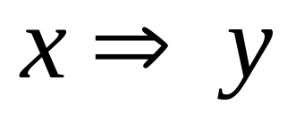
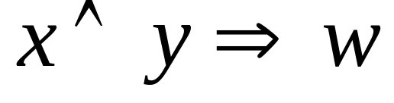
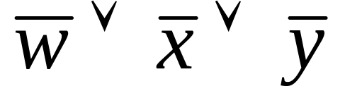
Goal
Given a horn formula, determine if the formula is satisfiable, i.e. an assignment of true/false to the variables that is consistent with all of the implications/causes
?

Slide 58
Goal
Given a horn formula, determine if the formula is satisfiable, i.e. an assignment of true/false to the variables that is consistent with all of the implications/causes
what do each of these encourage in the solution?

Slide 59
Goal
Given a horn formula, determine if the formula is satisfiable, i.e. an assignment of true/false to the variables that is consistent with all of the implications/causes
implications tell us to set some variables to true
negative clauses encourage us make them false

Slide 60
A brute force solution
Try each setting of the boolean variables and see if any of them satisfy the formula
For n variables, how many settings are there?
  2^{n}

Slide 61
A greedy solution?
w 0
x 0
y 0
z 0

Slide 62
A greedy solution?
w 0
x 1
y 0
z 0

Slide 63
A greedy solution?
w 0
x 1
y 1
z 0

Slide 64
A greedy solution?
w 1
x 1
y 1
z 0

Slide 65
A greedy solution?
w 1
x 1
y 1
z 0
not satisfiable

Slide 66
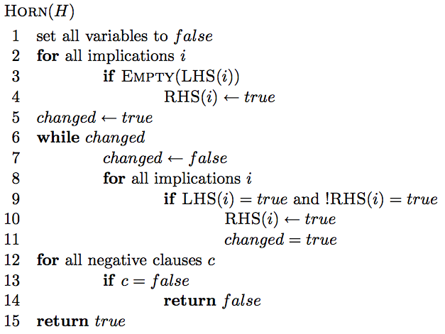
A greedy solution

Slide 67
A greedy solution
set all variables of the implications of the form “⇒x” to true

Slide 68
A greedy solution
if the all variables of the lhs of an implication are true, then set the rhs variable to true

Slide 69
A greedy solution
see if all of the negative clauses are satisfied

Slide 70
Correctness of greedy solution
Two parts:
  If our algorithm returns an assignment, is it a valid assignment?
  If our algorithm does not return an assignment, does an assignment exist?

Slide 71
Correctness of greedy solution
If our algorithm returns an assignment, is it a valid assignment?

Slide 72
Correctness of greedy solution
If our algorithm returns an assignment, is it a valid assignment?
explicitly check all negative clauses

Slide 73
Correctness of greedy solution
If our algorithm returns an assignment, is it a valid assignment?
don’t stop until all implications with all lhs elements true have rhs true

Slide 74
Correctness of greedy solution
If our algorithm does not return an assignment, does an assignment exist?
Our algorithm is “stingy”. It only sets those variables that have to be true. All others remain false.

Slide 75
Running time?
?
n = number of variables
m = number of formulas

Slide 76
Running time?
O(nm)
n = number of variables
m = number of formulas

Slide 77
Knapsack problems:
Greedy or not?
0-1 Knapsack – A thief robbing a store finds n items worth v₁, v₂, .., v_{n} dollars and weight w₁, w₂, …, w_{n} pounds, where v_{i} and w_{i} are integers. The thief can carry at most W pounds in the knapsack. Which items should the thief take if he wants to maximize value.
Fractional knapsack problem – Same as above, but the thief happens to be at the bulk section of the store and can carry fractional portions of the items. For example, the thief could take 20% of item i for a weight of 0.2w_{i} and a value of 0.2v_{i}.

